Slide 1
AIRBNB PRICING STRATEGY ANALYSIS
GROUP 6
TIEHAO CHEN/ YUEYUAN HE
CHENGHAO WU/ JIAN JIAN
23/APR/2020

Slide 2



INTRODUCTION
Who is Airbnb.

Slide 3
BUSINESS QUESTION
How can we help Airbnb hosts to adjust their pricing strategy to obtain the optimal gross margin?
What is the sentiment of guests in Seattle Airbnb for get feedback form them?

Slide 4
AGENDA
1.Data exploration
2.Data cleaning
3.Feature selection
4.Modeling and tuning
5.Sentiment analysis

Slide 5
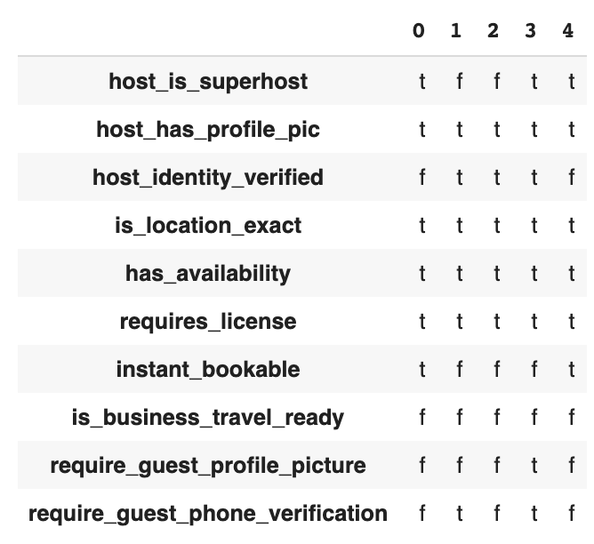
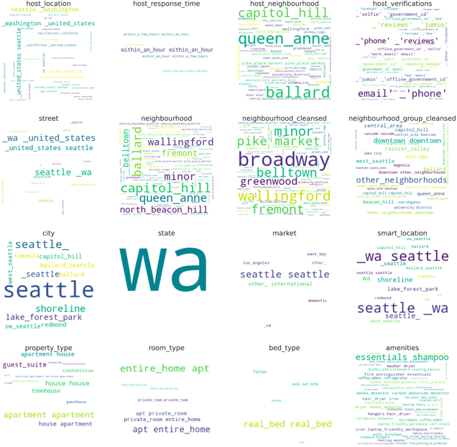
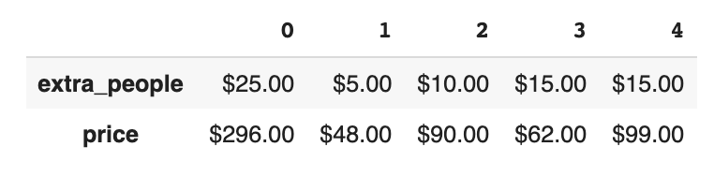
EXPLORATORY DATA ANALYSIS
Shape of the dataset: 9023 X 106
Different type of dataset:
Numerical features
Categorical ordinal/nominal features
Text comment features
URLs
PRELIMINARY DATA PROCESSING

Slide 6
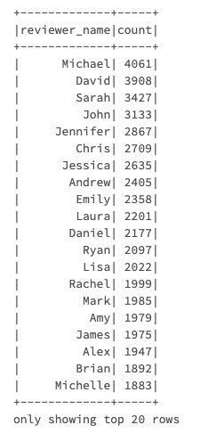
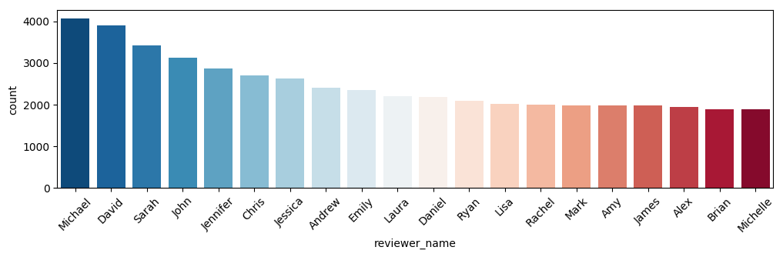
EXPLORATORY DATA ANALYSIS
Inference - Who likes Airbnb most
from 2008-09-15 to 2011-11-20?

Slide 7
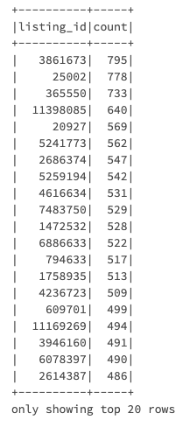
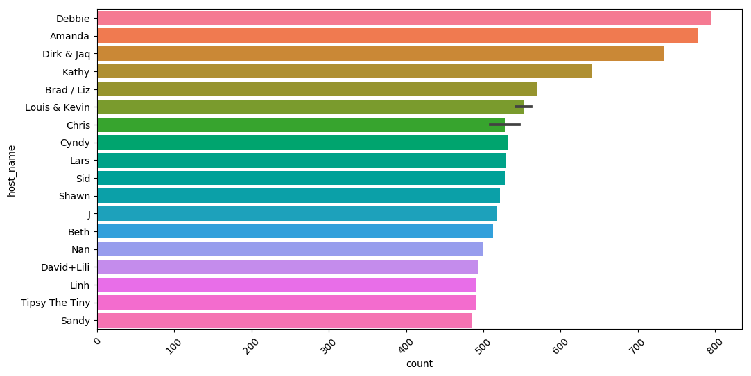
EXPLORATORY DATA ANALYSIS
Inference - Which house is the most popular？

Slide 8
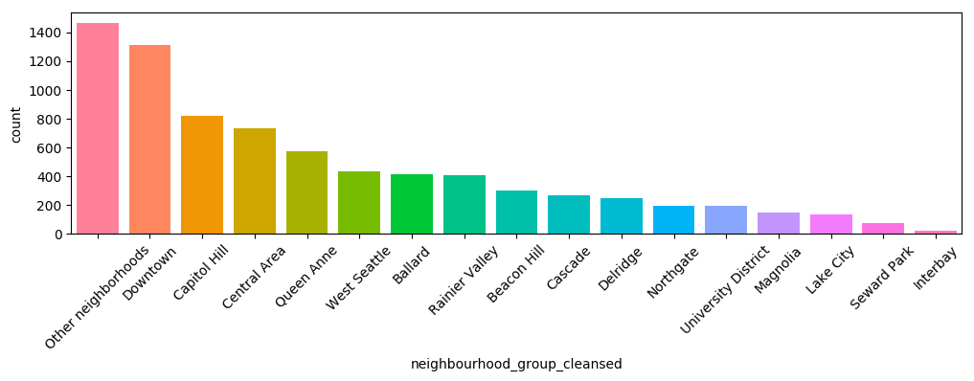
EXPLORATORY DATA ANALYSIS
Inference - Where is the most popular house？

Slide 9

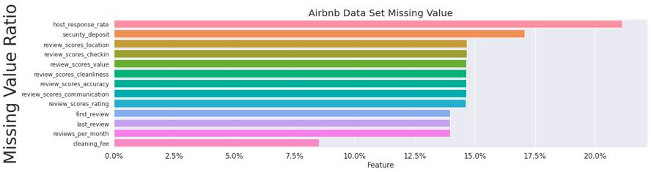
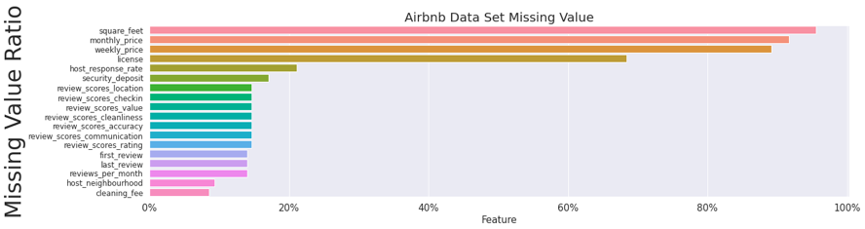
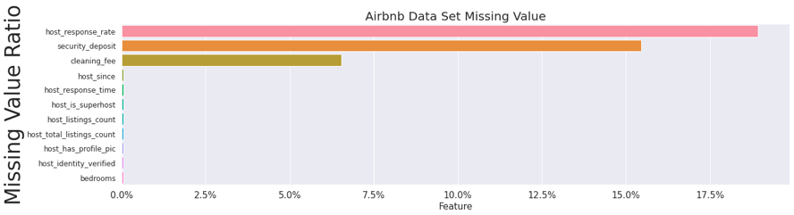
EXPLORATORY DATA ANALYSIS
MISSING VALUE IMPUTATION

Slide 10
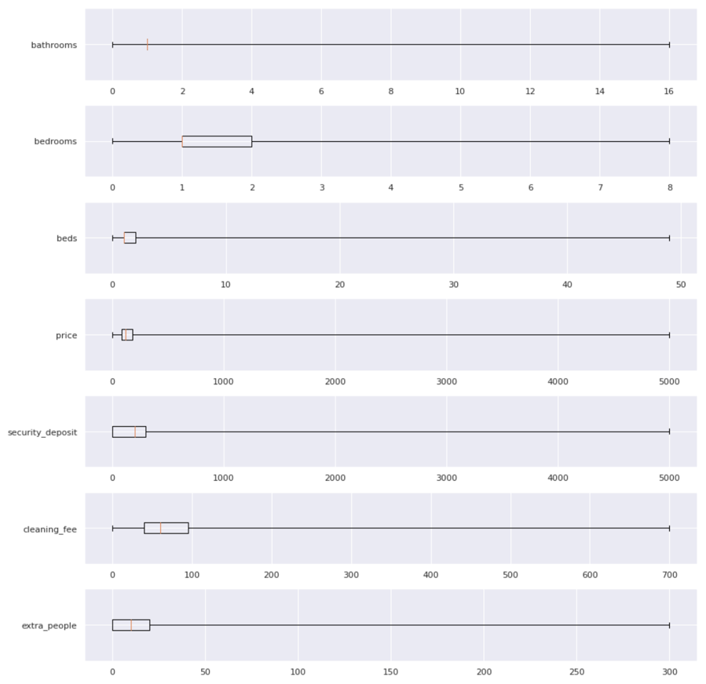
EXPLORATORY DATA ANALYSIS
INSPECT THE DISTRIBUTION OF EACH NUMERICAL FEATURE

Slide 11
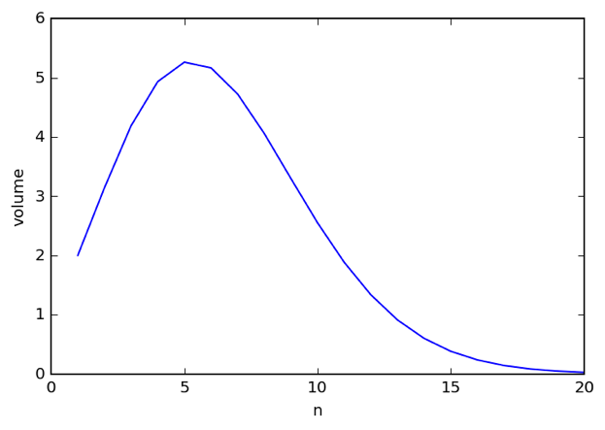
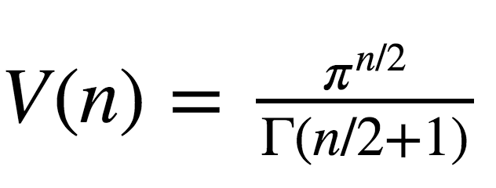
MODELING
LASSO REGRESSION

Slide 12
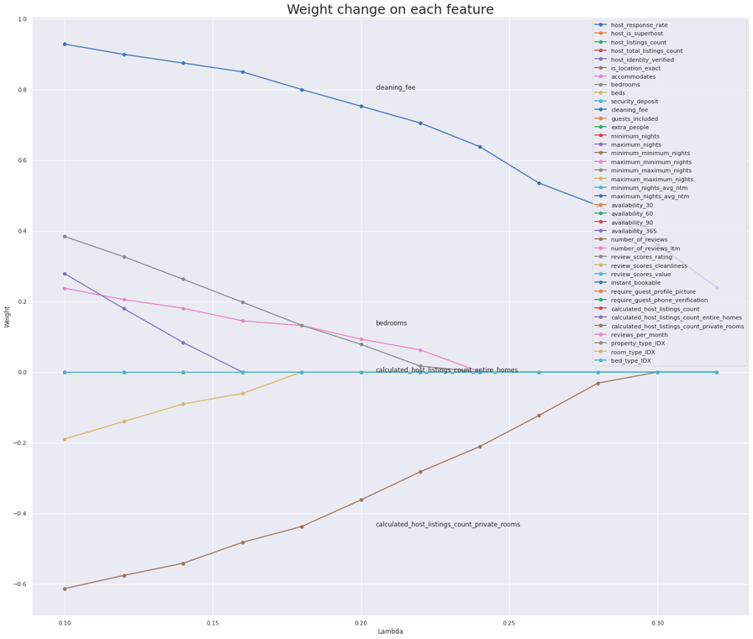
MODELING
LASSO REGRESSION

Slide 13
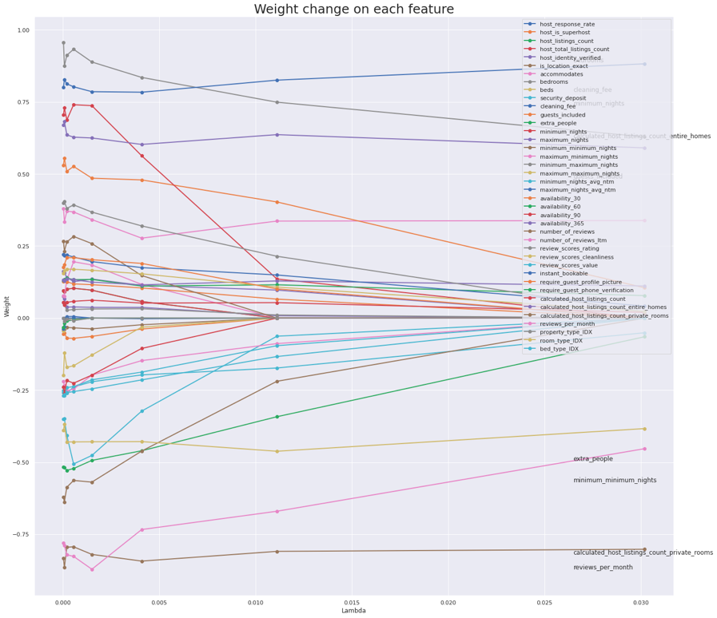
MODELING
LASSO REGRESSION

Slide 14
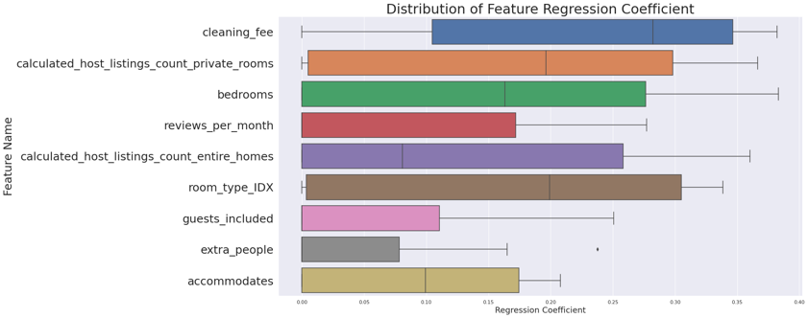
MODELING
ELASTIC NET SEARCH

Slide 15
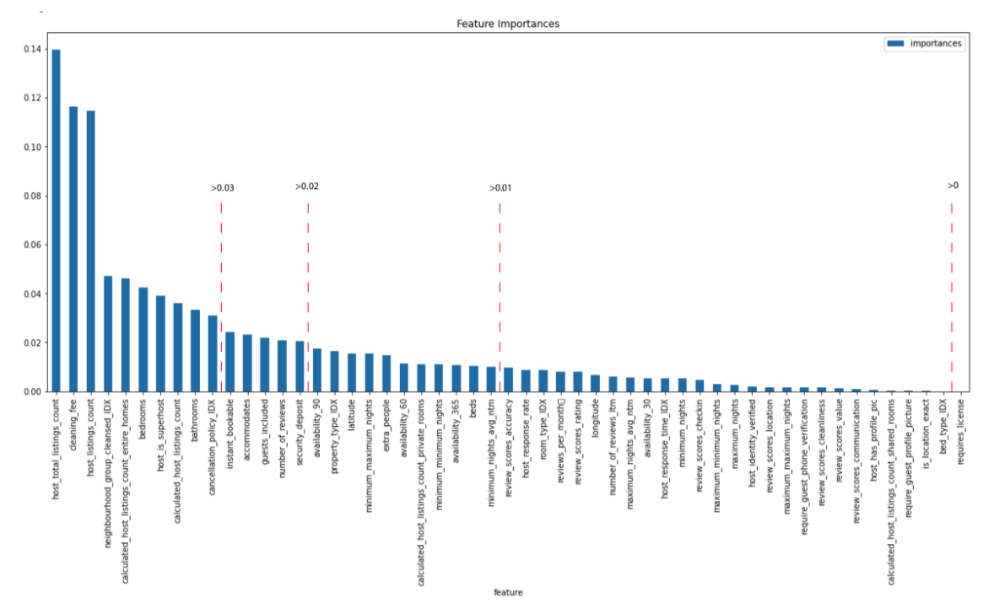
MODELING
FEATURE IMPORTANCE

Slide 16
WHAT HYPERPARAMETER ARE SELECTED FOR MODEL？
Random Forest Regressor:
Num of Trees: 5 10 15
Max of Depth: 5 10 15
GBT Regressor:
Num of Iteration: 5 10 15
Max of Depth: 5 10 15

Slide 17
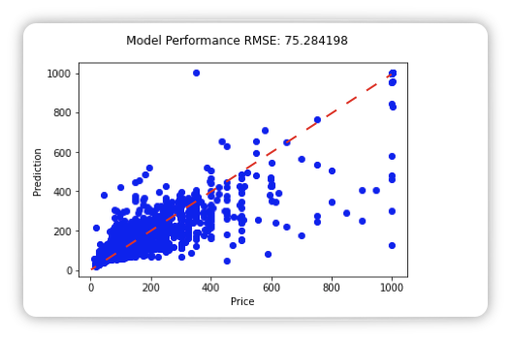
MODELING
RANDOM FOREST REGRESSOR
FEATURE SELECTION: IMPORTANCE > 0
BEST MODEL HYPERPARAMETER:
NUMBER OF TREES - 15
MAX DEPTH - 15
R^2 - 0.778989

Slide 18
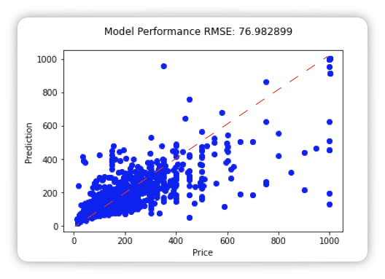
MODELING
RANDOM FOREST REGRESSOR
FEATURE SELECTION: IMPORTANCE > 0.01
BEST MODEL HYPERPARAMETER:
NUMBER OF TREES - 15
MAX DEPTH - 15
R^2 - 0.768903

Slide 19

MODELING
RANDOM FOREST REGRESSOR
FEATURE SELECTION: IMPORTANCE > 0.02
BEST MODEL HYPERPARAMETER:
NUMBER OF TREES - 15
MAX DEPTH - 15
R^2 - 0.783354

Slide 20
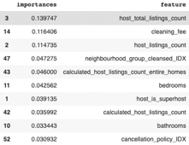
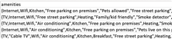
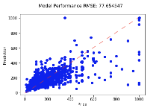
MODELING
RANDOM FOREST REGRESSOR
FEATURE SELECTION: IMPORTANCE > 0.03
BEST MODEL HYPERPARAMETER:
NUMBER OF TREES - 15
MAX DEPTH - 15
R^2 - 0.764853

Slide 21
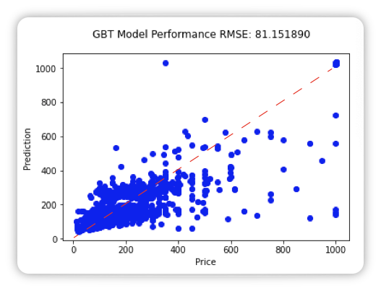
MODELING
GBT REGRESSOR
FEATURE SELECTION: IMPORTANCE > 0
BEST MODEL HYPERPARAMETER:
NUMBER OF ITERATIONS - 15
MAX DEPTH - 5
R^2 - 0.743195

Slide 22
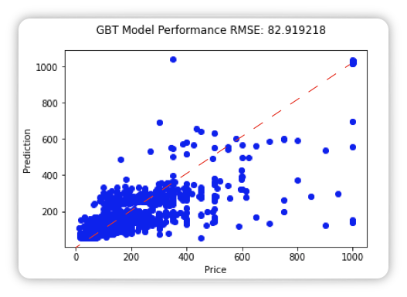
MODELING
GBT REGRESSOR
FEATURE SELECTION: IMPORTANCE > 0.01
BEST MODEL HYPERPARAMETER:
NUMBER OF ITERATIONS - 15
MAX DEPTH - 5
R^2 - 0.731888

Slide 23

MODELING
GBT REGRESSOR
FEATURE SELECTION: IMPORTANCE > 0.02
BEST MODEL HYPERPARAMETER:
NUMBER OF ITERATIONS - 15
MAX DEPTH - 5
R^2 - 0.732999

Slide 24
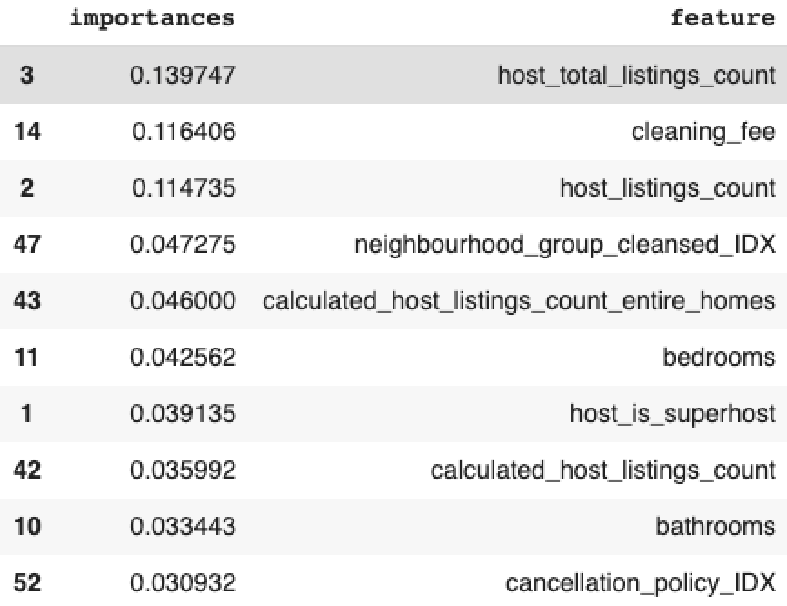
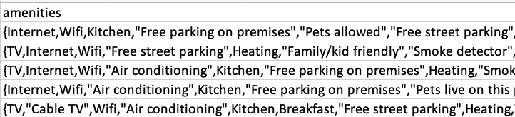
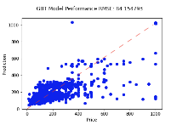
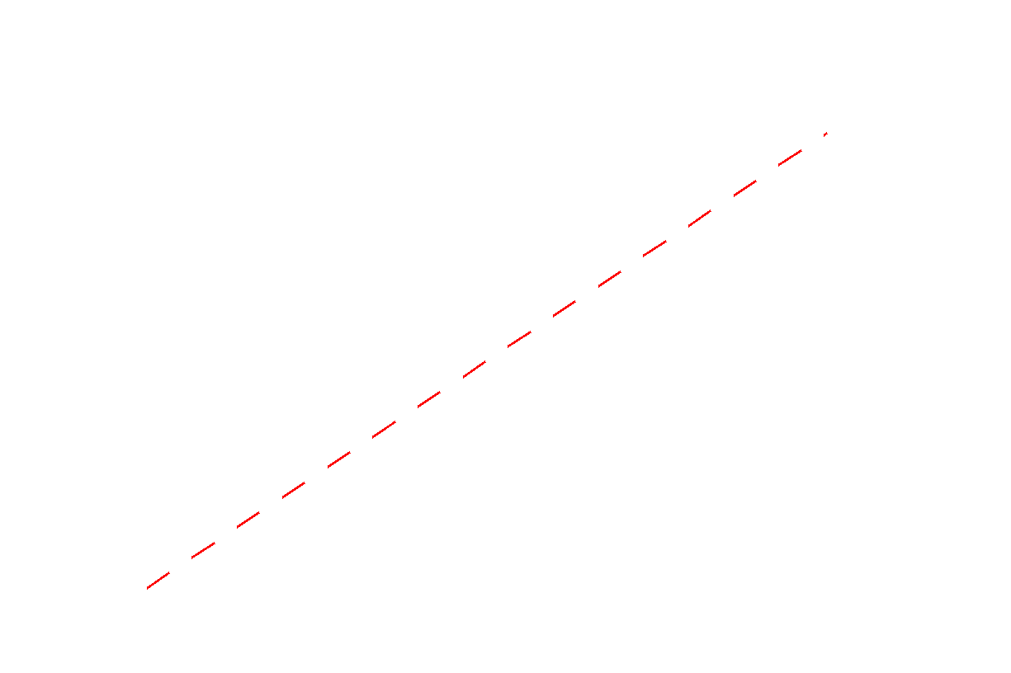
MODELING
GBT REGRESSOR
FEATURE SELECTION: IMPORTANCE > 0.03
BEST MODEL HYPERPARAMETER:
NUMBER OF ITERATIONS - 15
MAX DEPTH - 5
R^2 - 0.723838

Slide 25
INSIGHTS
1. Random Forest model have a best performance to predict price of hotel
2. Airbnb company can advice old hosts and new hosts· on how to price their house or apartment in the future
3. A reasonable price can attract more customers to book hotel on Airbnb, they will be more competitive in the market.

Slide 26
DESCRIPTION TERM FREQUENCY ANALYSIS
What is the most frequent words in high
Rated Airbnb?
Language detect
Term frequency

Slide 27
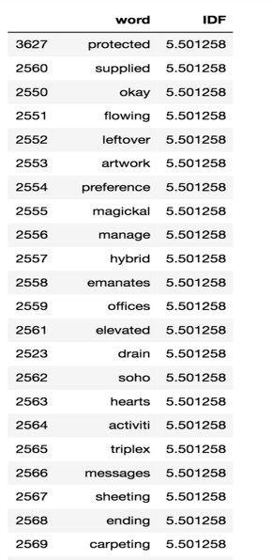
DESCRIPTION SELECT
LANGUAGE DETECT
TFIDF
WE ONLY CHOOSE THE DESCRIPTION WITH RATING SCORE HIGHER THAN 95 AND IDENTIFY THEM AS GREAT AIRBNB.
WE FOUND THERE ARE SOME LANGUAGES ARE NOT ENGLISH:
1.ENGLISH (WHAT WE NEED)
2.FRENCH
3.CHINESE
4.KOREAN
5.GERMANY

Slide 28
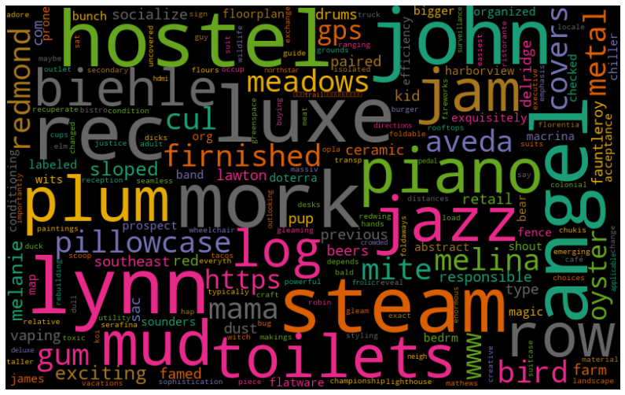
DESCRIPTION WORD CLOUD
HOSTELS ARE TEND TO GET HIGH RATED SCORE.
JOHN PROBABLY IS A GOOD HOST.
MUSIC PROVIDED AIRBNB COULD GET A HIGH SCORE
AIRBNBS ON LYNN STREET COULD BE A GOOD PLACE FOR STAY

Slide 29
REVIEWS SENTIMENT ANALYSIS
What is users’ sentiment about Airbnbs in Seattle?
Language detect
Sentiment Label
Sentiment analyze
Sentiment prediction model
Model tuning

Slide 30
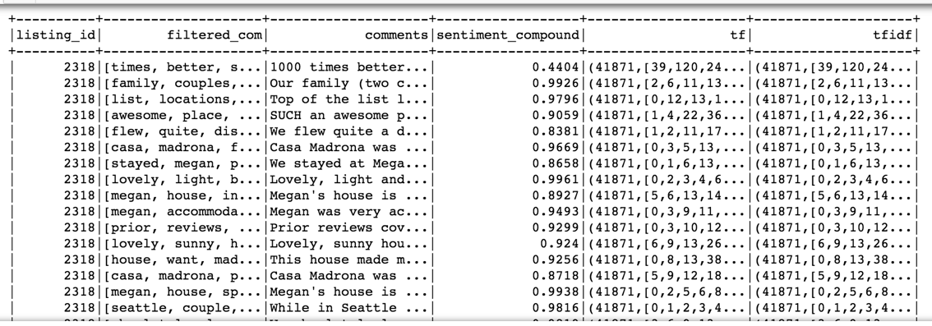
LANGUAGE DETECT AND SENTIMENT LABEL
Use only English reviews because we cannot determine the sentiment of foreign language
Give each comments its compound sentiment score by using SentimentIntensityAnalyzer
Label 1(positive) if the compound score >0, otherwise 0(negative)

Slide 31
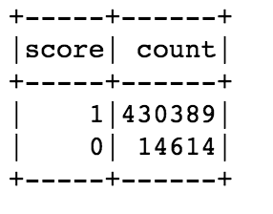
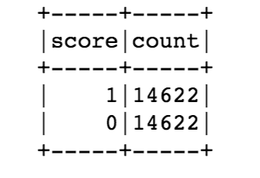
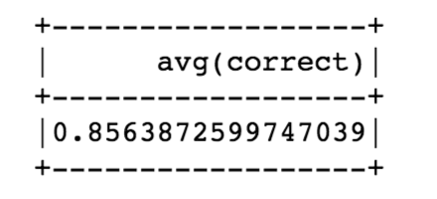
SENTIMENT ANALYSIS AND PREDICT MODEL BUILDING
Sentiment analysis
We have positive reviews way much more than negative ones
Model building:
Dataset balenced
Num of Iteration: 100
Accracy:0.856387
Logistic regression

Slide 32
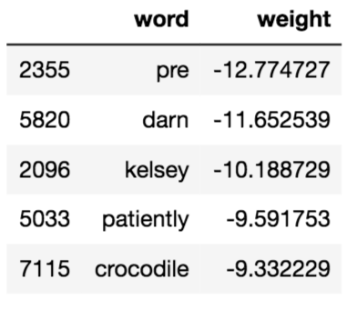
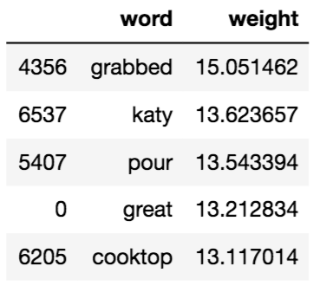
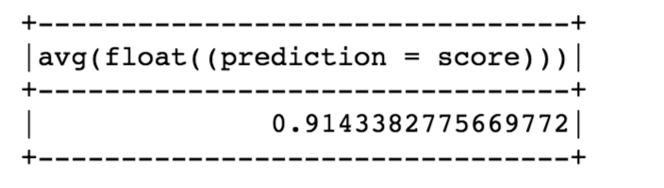
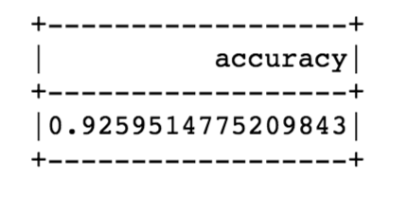
MODEL TUNING
Too much noise:
We have too many features compared to examples, which will cause overfitting.
The words doesn’t make sense.
Model tuning: Elastic net regularization
𝜆=0.02 , 𝛼=0.3(for test)
Accuracy=0.914338
Use ParamGridBuilder to select best
hyperparameter. 𝜆=0.01, 𝛼= 0.2
Accuracy2=0.92595

Slide 33
RECOMMENDATION SYSTEM
Based on Users (the score of reviewers)
Based on House (Location, amenities, etc.)
Depth-based on Users (User Profile)
Hybrid Recommender Systems
…

Slide 34
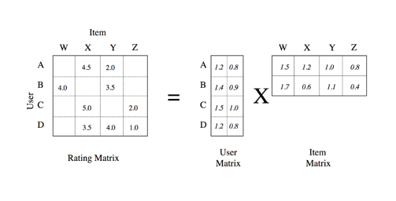
ALS
COLLABORATIVE
FILTERING
Based on Users (the score of reviewers)
Based on House (Location, amenities, etc.)
Depth-based on Users (User Profile)
Hybrid Recommender Systems
…

Slide 35
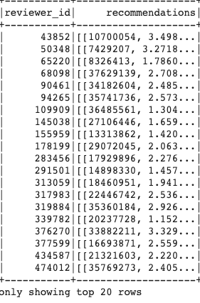
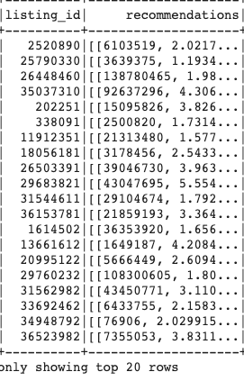
RECOMMENDATION SYSTEM

Slide 36
RECOMMENDATION SYSTEM
Based on Users (the score of reviewers)
Based on House (Location, amenities, etc.)
Depth-based on Users (User Profile)
Hybrid Recommender Systems
…

Slide 37
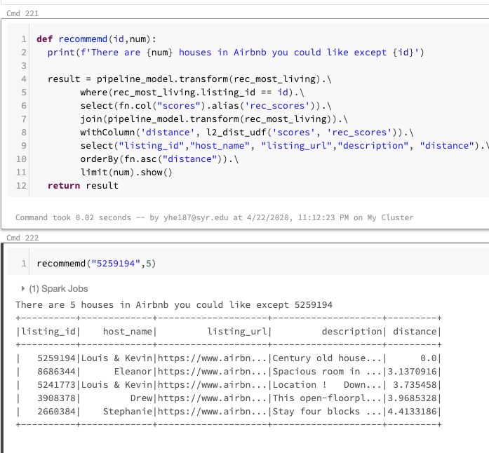
RECOMMENDATION SYSTEM
Based on Users (the score of reviewers)
Based on House (Location, amenities, etc.)
Depth-based on Users (User Profile)
Hybrid Recommender Systems
…

Slide 38
SUMMARY
Airbnb with music provided tend to get higher score
Hostels are high scored airbnb probably because its low cost.
The Airbnb on certain street tend to get higher rate.
Most of airbnb guests have positive attitude in Seattle.
…

Slide 39
THANK YOU
Group 6
Tiehao Chen/ Yueyuan He
Chenghao Wu/ Jian Jian
23/apr/2020

